Slide 1
INCLINATION AND SLOPE OF A LINE

Slide 2
INCLINATION AND SLOPE OF A LINE
The inclination of the line L, (not parallel with the x-axis) is defined as the smallest positive angle measured from the positive direction of the x-axis in a counterclockwise direction to L.
The slope of the line is defined as the tangent of the angle of inclination.

Slide 3
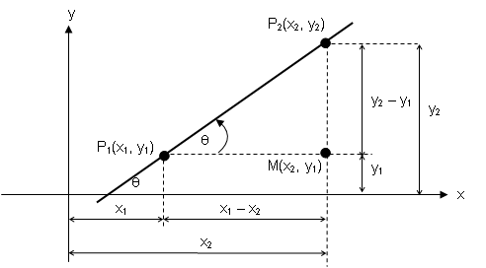

Slide 4
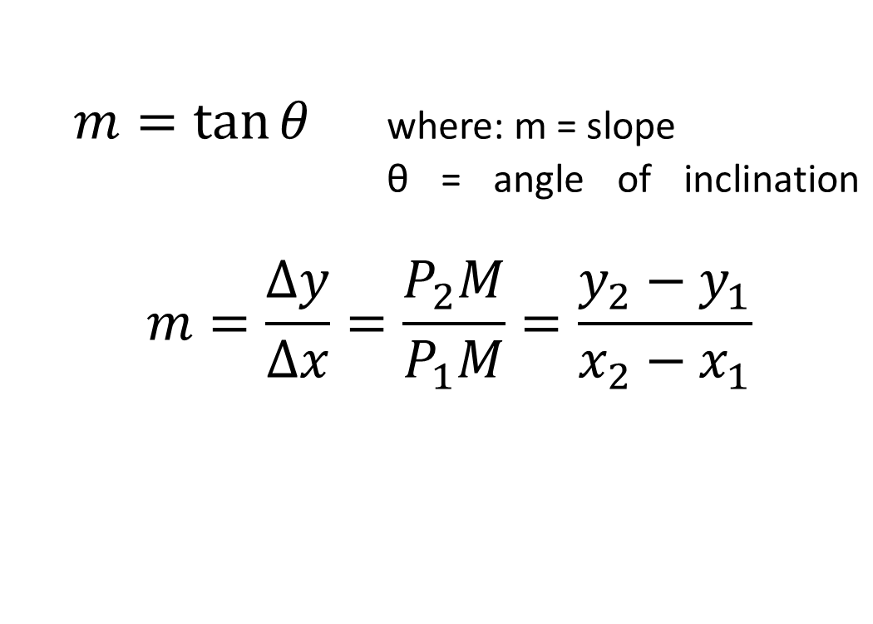

Slide 5

PARALLEL AND PERPENDICULAR LINES
If two lines are parallel their slope are equal. If two lines are perpendicular the slope of one of the line is the negative reciprocal of the slope of the other line.
If m₁ is the slope of L₁ and m₂ is the slope of L₂ then, or m₁m₂ = -1.

Slide 6
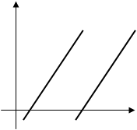
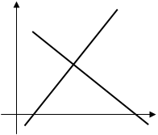














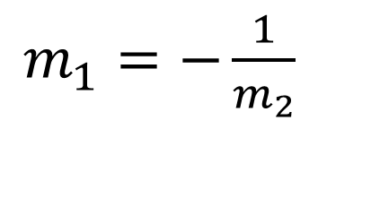

y
y
x

Slide 7
Sign Conventions:
Slope is positive (+), if the line is leaning to the right.
Slope is negative (-), if the line is leaning to the left.
Slope is zero (0), if the line is horizontal.
Slope is undefined ( ), if the line is vertical.

Slide 8
Examples:
1. Find the slope, m, and the angle of inclination, θ, of the lines through each of the following pair of points.
  (-8, -4) and (5, 9)
  (10, -3) and (14, -7)
  (-11, 8) and (-11, 2)
  (8, 6) and (14, 6)
2. The line segment drawn from (x, 3) to (4, 1) is perpendicular to the segment drawn from (-5, -6) to (4, 1). Find the value of x.

Slide 9
3. Show that the points A(-2, 6), B(5, 3), C(-1, -11) and D(-8, -8) are the vertices of a parallelogram. Is the parallelogram a rectangle?
4. Show that the points A(-1, -1), B(-1, -5) and C(12, 4) lie on a straight line.

Slide 10
ANGLE BETWEEN TWO INTERSECTING LINES

Slide 11
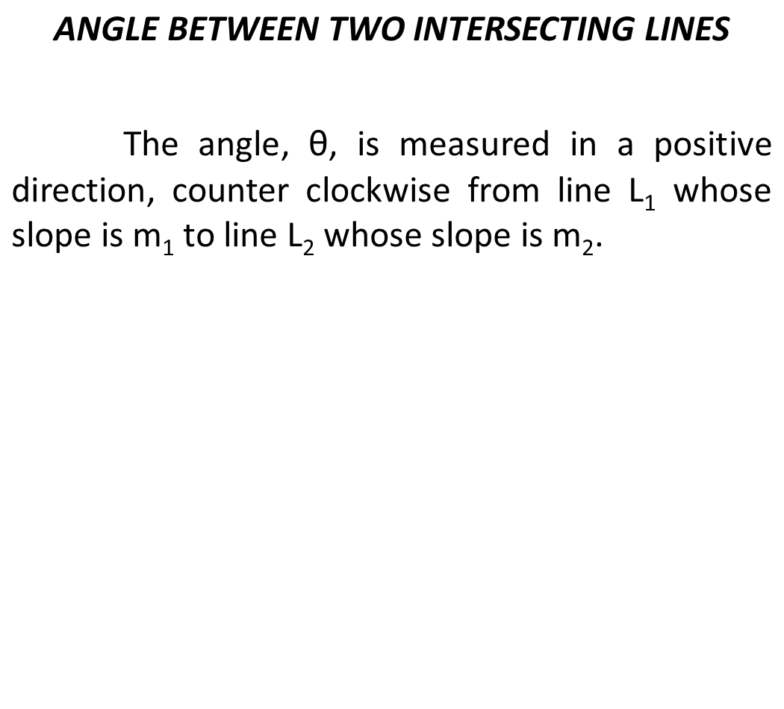








y

Slide 12
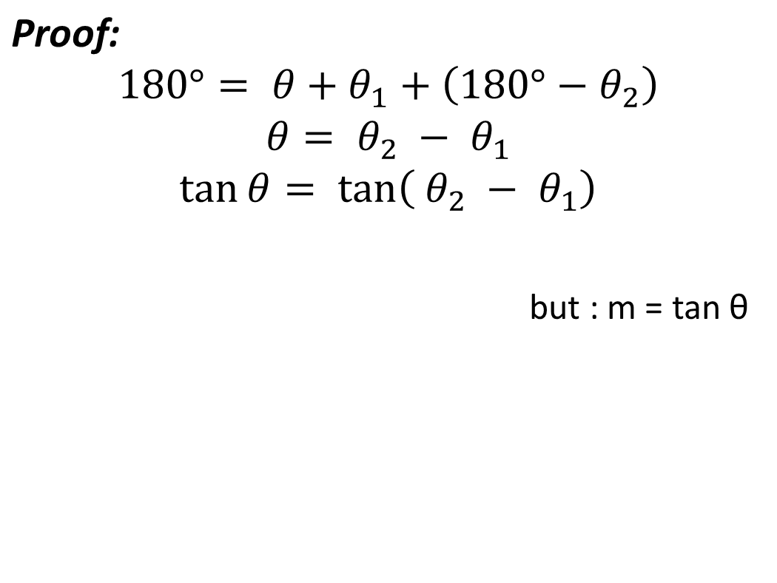




Slide 13
Examples:
The line through the points (-1, 6) and (5, -2) intersects the line through (4, -4) and (1,7). Determine the angle between these two intersecting lines.
The angle from the line through (x, -1) and (-3, -5) to the line through (2, -5) and (4, 1) is 45 . Find x.
Find the interior angles of the triangle whose vertices are A (-3, -2), B (2, 5) and C (4,2).

Slide 14
End of Discussion

Slide 15
4. Show that the triangle whose vertices are A(8, -4), B(5, -1) and C(-2,-8) is a right triangle.
5. Show that the points A(-2, 6), B(5, 3), C(-1, -11) and D(-8, -8) are the vertices of a parallelogram. Is the parallelogram a rectangle?
6. Find y if the slope of the line segment joining (3, -2) to (4, y) is -3.
7. Show that the points A(-1, -1), B(-1, -5) and C(12, 4) lie on a straight line.

Slide 16
Examples:
The line through the points (-1, 6) and (5, -2) intersects the line through (4, -4) and (1,7). Determine the angle between these two intersecting lines.
The angle from the line through (x, -1) and (-3, -5) to the line through (2, -5) and (4, 1) is 45 . Find x.
Two lines passing through (2, 3) make an angle of 45 . If the slope of one of the lines is 2, find the slope of the other.
Find the interior angles of the triangle whose vertices are A (-3, -2), B (2, 5) and C (4,2).

